Slide 1
2.1 Theory – BASICS Entity / Relationship Model
name
address
One to one: e.g. a president runs the studio (assuming that each studio has 1 president and that every studio is run by one president)
One to many (parent child): e.g. one movie is at most owned by one studio. One studio can have mutiple movies
Many to many: One star can perform in multiple movies
star
stars in
title
year
name
…
name
movies
owns
president
runs
studio
length
genre
address
keys of an entity are one or more attributes that are unique

Slide 2
2.1 Theory – BASICS Entity / Relationship Model
name
address
Entities - object / representation
Relations – relation between objects
Attributes – characteristics of an entity
star
stars in
title
year
name
movies
owns
studio
length
genre
address
An entity-relationship diagram for movie database
Garcia-Molina et al., 2009 p124 figure 2
There are many variations!

Slide 3
2.1 Theory – BASICS Entity / Relationship Model
name
address
One to one: e.g. a president runs the studio (assuming that each studio has 1 president and that every studio is run by one president)
One to many (parent child): e.g. one movie is at most owned by one studio. One studio can have mutiple movies
Many to many: One star can perform in multiple movies
star
stars in
title
year
name
…
name
movies
owns
president
runs
studio
length
genre
address
keys of an entity are one or more attributes that are unique

Slide 4
user_id
info
modified_date
venue_id
info
s_order
film_id
country
production_company
film_director
number_of_screens
title
film_length
editorial_comment
date_opened
tblvenuescreen
fiction
tblfilm
film_gauge
gemeentena
created_date
film_year
imdb
gml_id
geom
has
info
contains
Code
Municipalities_NL
editorial_comment
venue_id
user_id
live_performance
film_id
name
modified_date
tblprogrammeitem
programme_id
location_id
tblvenue
venue_type
contains
geodata
created_date
contains
modified_date
editorial_comment
country
venue_id
user_id
location_id
Is located at
has
was active
has
programme_date
postal_code
tblprogramme
programme_bookkeeping
created_date
tbllocation
programme_infoa
tblvenueseats
tblvenueactiveperiode
created_date
user_id
programme_id
programme_title
programme_provenance
seats_year
number_of_seats
venue_id
s_order
accommodation_info
modified_date
date_opened
first_sound
venue_id
s_order
date_checked
date_closed

Slide 5
venue_id
info
s_order
number_of_screens
Referential integrity (§3.3)
Contraint that every venue must have a number of seats.
Every venue was active in a certain period
Not every venue it noted in a programme (e.g. cinemas showing adult content)
date_opened
tblvenuescreen
has
info
editorial_comment
venue_id
user_id
name
modified_date
location_id
tblvenue
venue_type
created_date
editorial_comment
modified_date
venue_id
created_date
user_id
has
was active
has
programme_date
tblprogramme
programme_bookkeeping
tblvenueseats
tblvenueactiveperiode
programme_infoa
programme_id
programme_title
programme_provenance
seats_year
number_of_seats
venue_id
s_order
accommodation_info
date_opened
first_sound
venue_id
s_order
date_checked
date_closed

Slide 6
venue_id
info
s_order
Weak Entity sets (§4)
Containing a foreign key and requires another attribute to be unique
tblvenueseats
seats_year & venue_id
tblvenueactiveperiode
venue_id & date_opened
tblvenuescreen
venue_id & date_opened
tblprogramme
Not, since programme_id makes is unique
number_of_screens
date_opened
tblvenuescreen
has
info
editorial_comment
venue_id
user_id
name
modified_date
location_id
tblvenue
venue_type
created_date
editorial_comment
modified_date
venue_id
created_date
user_id
has
was active
has
programme_date
tblprogramme
programme_bookkeeping
tblvenueseats
tblvenueactiveperiode
programme_infoa
programme_id
programme_title
programme_provenance
seats_year
number_of_seats
venue_id
s_order
accommodation_info
date_opened
first_sound
venue_id
s_order
date_checked
date_closed

Slide 7
venue_id
info
s_order
number_of_screens
date_opened
tblvenuescreen
gemeentena
geom
gml_id
has
editorial_comment
info
Code
Municipalities_NL
venue_id
user_id
name
modified_date
location_id
tblvenue
venue_type
contains
geodata
created_date
editorial_comment
modified_date
country
venue_id
created_date
user_id
location_id
Is located at
has
was active
has
programme_date
postal_code
tblprogramme
programme_bookkeeping
created_date
tbllocation
programme_infoa
tblvenueseats
tblvenueactiveperiode
user_id
programme_id
programme_title
programme_provenance
seats_year
number_of_seats
venue_id
s_order
accommodation_info
modified_date
date_opened
first_sound
venue_id
s_order
date_checked
date_closed

Slide 8
user_id
info
modified_date
venue_id
info
s_order
film_id
country
production_company
film_director
number_of_screens
title
film_length
editorial_comment
date_opened
tblvenuescreen
fiction
tblfilm
film_gauge
gemeentena
created_date
film_year
imdb
gml_id
geom
has
info
contains
Code
Municipalities_NL
editorial_comment
venue_id
user_id
live_performance
film_id
name
modified_date
tblprogrammeitem
programme_id
location_id
tblvenue
venue_type
contains
geodata
created_date
contains
modified_date
editorial_comment
country
venue_id
user_id
location_id
Is located at
has
was active
has
programme_date
postal_code
tblprogramme
programme_bookkeeping
created_date
tbllocation
programme_infoa
tblvenueseats
tblvenueactiveperiode
created_date
user_id
programme_id
programme_title
programme_provenance
seats_year
number_of_seats
venue_id
s_order
accommodation_info
modified_date
date_opened
first_sound
venue_id
s_order
date_checked
date_closed

Slide 9
venue_id
film_id
date_opened
tblvenuescreen
tblfilm
has
contains
Municipalities_NL
venue_id
film_id
tblprogrammeitem
programme_id
location_id
tblvenue
contains
contains
has
venue_id
location_id
Is located at
has
was active
tblprogramme
tbllocation
tblvenueseats
tblvenueactiveperiode
programme_id
seats_year
venue_id
date_opened
venue_id

Slide 10
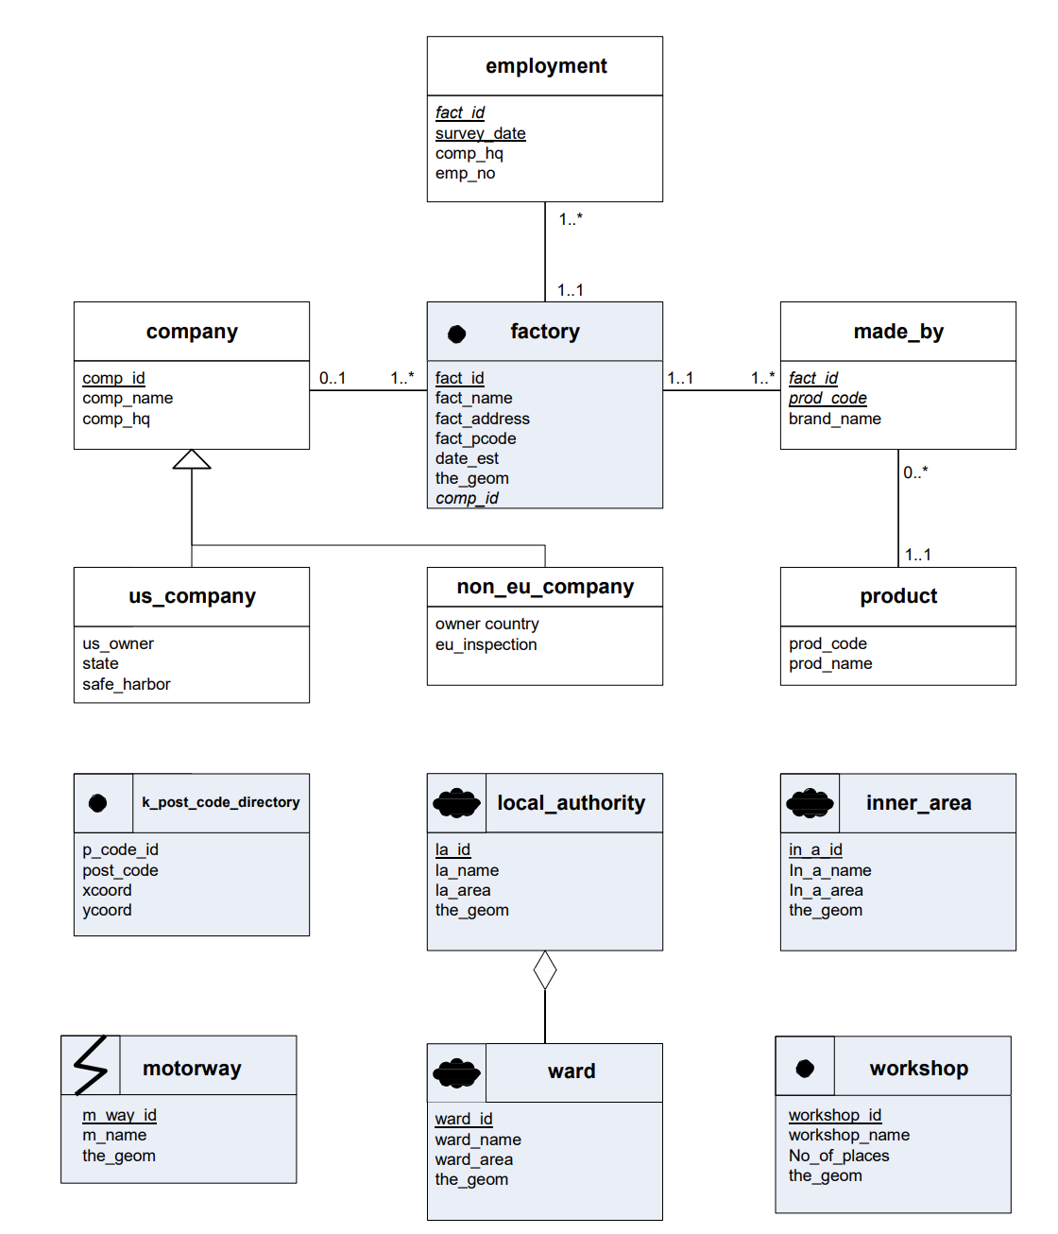
1..1 : exactly one
0..1 : zero or one
* :zero or more
1..* :one or more
There are many variations!

Slide 11
tblvenueactiveperiode
1..*
venue_id
date_opened
date_closed
date_checked
s_order
tblvenueseats
1..*
venue_id
seats_year
number_of_seats
s_order
tblvenue
venue_id
location_id
name
venue_type
first_sound_date
info
editorial_comment
created_date
modified_date
user_id
1..1
1..*
tblvenuescreens
1..*
venue_id
number_of_screens
date_opened
info
s_order
Municipalities_NL
tbllocation
tblprogramme
tblprogrammeitem
tblfilm
1..1
1..1
1..*
1..1
1..*
programme_id
venue_id
first_sound
programme_title
programme_provenance
programme_info
accommodation_info
programme_bookkeeping
editorial_comment
created_date
modified_date
user_id
programme_id
film_id
live_performance
film_id
title
film_year
country
production_company
film_director
film_length
film_gauge
imdb
info
editorial_comment
created_date
modified_date
user_id
geom
gml_id
code
Gemeentena
location_id
country
postal_code
geodata
created_date
modified_date
user_id
0..*
1..*
1..1

Slide 12
tblvenueactiveperiode
1..*
venue_id
date_opened
date_closed
date_checked
s_order
PK
tblvenueseats
1..*
venue_id
seats_year
number_of_seats
s_order
PK
tblvenue
venue_id
location_id
name
venue_type
first_sound_date
info
editorial_comment
created_date
modified_date
user_id
1..1
1..*
PK
PK
tblvenuescreens
1..*
venue_id
date_opened
number_of_screens
info
s_order
PK
Municipalities_NL
tbllocation
tblprogramme
tblprogrammeitem
tblfilm
1..1
PK
PK
1..1
1..*
PK
PK
1..1
1..*
programme_id
venue_id
first_sound
programme_title
programme_provenance
programme_info
accommodation_info
programme_bookkeeping
editorial_comment
created_date
modified_date
user_id
programme_id
film_id
live_performance
film_id
title
film_year
country
production_company
film_director
film_length
film_gauge
imdb
info
editorial_comment
created_date
modified_date
user_id
geom
gml_id
code
Gemeentena
location_id
country
postal_code
geodata
created_date
modified_date
user_id
0..*
PK
PK
1..*
1..1

Slide 13
tblvenueactiveperiode
Aggregation and compositions [1]
(0..1) Aggregation implies a relationship where the child can exist independently of the parent. Example: Class (parent) and Student (child). Delete the Class and the Students still exist.
(1..1) Composition implies a relationship where the child cannot exist independent of the parent. Example: House (parent) and Room (child). Rooms don't exist separate to a House.
1..*
venue_id
date_opened
date_closed
date_checked
s_order
PK
tblvenueseats
1..*
venue_id
seats_year
number_of_seats
s_order
PK
tblvenue
1..1
venue_id
location_id
name
venue_type
first_sound_date
info
editorial_comment
created_date
modified_date
user_id
1..*
PK
PK
0..1
tblvenuescreens
1..*
venue_id
date_opened
number_of_screens
info
s_order
PK
Placed at the parent side
Municipalities_NL
tbllocation
tblprogramme
tblprogrammeitem
tblfilm
1..1
1..*
0..1
0..1
0..*
PK
PK
PK
PK
programme_id
venue_id
first_sound
programme_title
programme_provenance
programme_info
accommodation_info
programme_bookkeeping
editorial_comment
created_date
modified_date
user_id
programme_id
film_id
live_performance
PK
geom
gml_id
code
Gemeentena
1..*
location_id
country
postal_code
geodata
created_date
modified_date
user_id
film_id
title
film_year
country
production_company
film_director
film_length
film_gauge
imdb
info
editorial_comment
created_date
modified_date
user_id
PK
1..*
1..1
[1] https://www.visual-paradigm.com/guide/uml-unified-modeling-language/uml-aggregation-vs-composition/

Slide 14
The Cinema Context dataset does not have the full program of all films shown. At the moment is it thus not possible to reconstruct how many times a certain film has been shown. How would you change/adapt the database structure of Cinema Context and from which attribute would you derive this additional information? Explain your answer and provide an extension to the E/R and the UML diagrams.

Slide 15
tblvenueactiveperiode
1..*
venue_id
date_opened
date_closed
date_checked
s_order
PK
tblvenueseats
1..*
venue_id
seats_year
number_of_seats
s_order
PK
tblvenue
1..1
venue_id
location_id
name
venue_type
first_sound_date
info
editorial_comment
created_date
modified_date
user_id
1..*
PK
PK
0..1
tblvenuescreens
1..*
venue_id
date_opened
number_of_screens
info
s_order
PK
tblfilmshown
0..*
PK
film_id
date
hour_start
Municipalities_NL
tbllocation
tblprogramme
tblprogrammeitem
tblfilm
1..*
0..1
0..1
0..*
PK
PK
1..1
PK
PK
1..*
programme_id
venue_id
first_sound
programme_title
programme_provenance
programme_info
accommodation_info
programme_bookkeeping
editorial_comment
created_date
modified_date
user_id
programme_id
film_id
live_performance
PK
geom
gml_id
code
Gemeentena
location_id
country
postal_code
geodata
created_date
modified_date
user_id
film_id
title
film_year
country
production_company
film_director
film_length
film_gauge
imdb
info
editorial_comment
created_date
modified_date
user_id
PK
1..*
1..1

Slide 16
E/R is dedicated to depict real world entities and their relationships to each other and used to develop databases only
UML is not only for databases, but foremost used for software development, thus more people can use / read it
UML are more used and considered the industry standard
UML are more structured and lean.

Slide 17
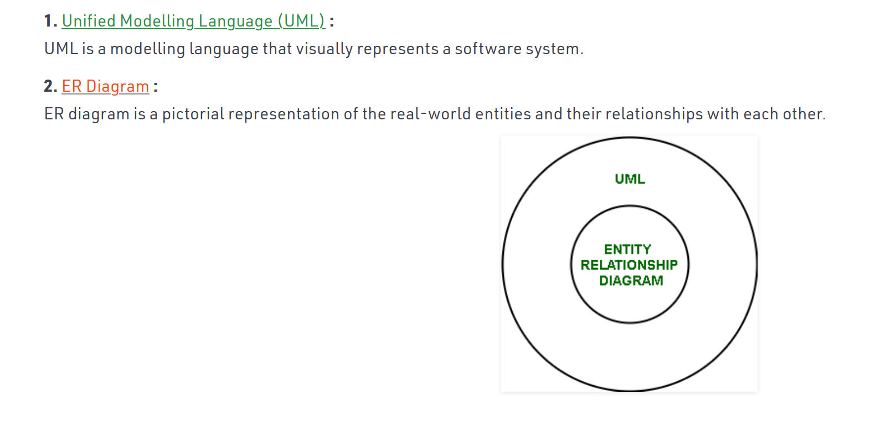
https://www.geeksforgeeks.org/difference-between-uml-and-er-diagram/

Slide 18
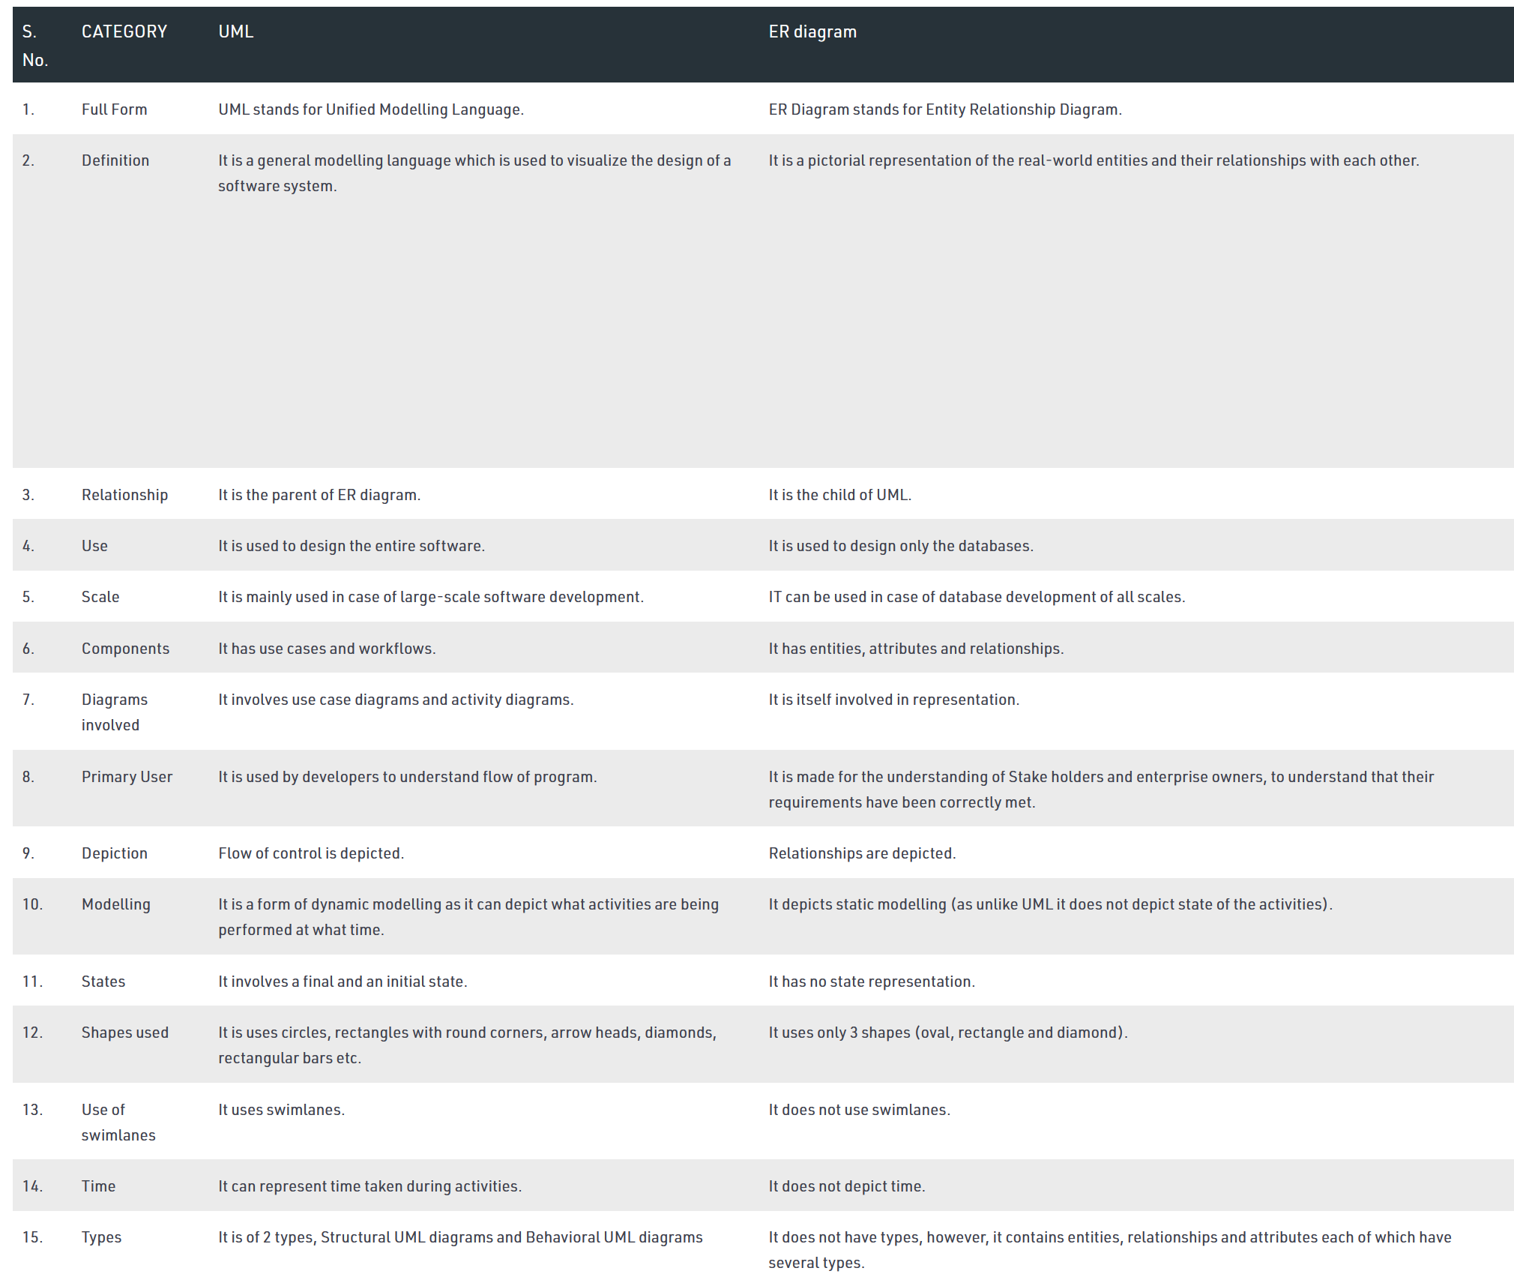
https://www.geeksforgeeks.org/difference-between-uml-and-er-diagram/

